Slide 1


Smart Recycling System
Sai Parkhe
Gayatri Adatiya
Abhishek Khemnar
Shreyanshu Owhal
Guide:Sarthak Narnor
College Name - PES Modern College of Engineering Pune-05

Slide 2

Project Objectives
Problem Statement
Project Overview – Introduction
End Users
Wow Factor in Project
Modelling/Block Diagram/Flow of Project
Result/outcomes
Conclusion
References
Future Perspective

Slide 3
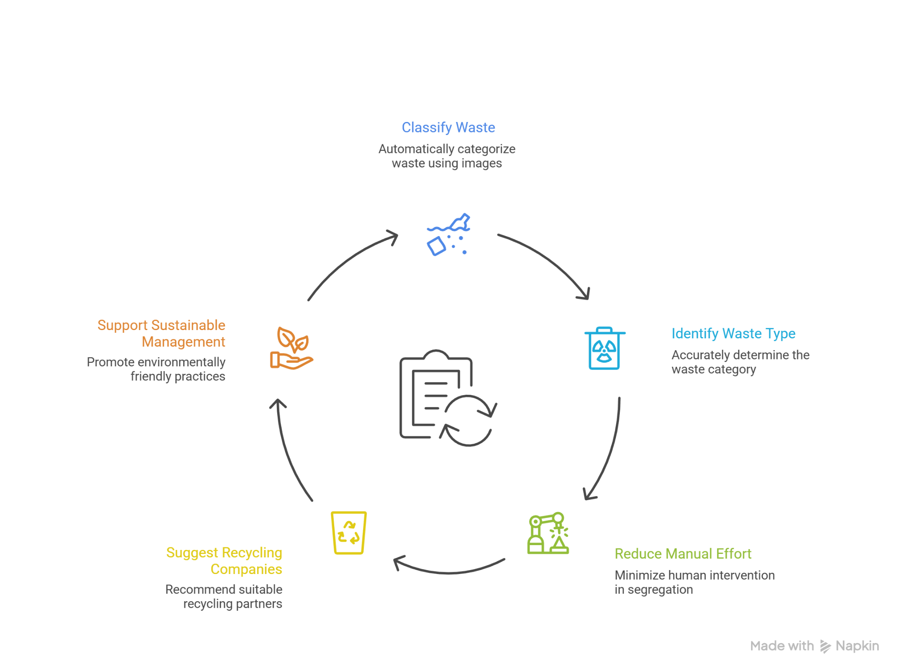
Problem Statement and Objective
Based on Smart Recycling System
Improper waste segregation leads to recyclable materials being lost in landfills, causing environmental harm.There is a need for an automated system to accurately classify waste and direct it to appropriate recycling channels.
Objectives
1.To classify waste automatically using images.
2.To identify the type of waste accurately.
3.To reduce manual waste segregation effort.
4.To suggest suitable recycling companies.
5.To support efficient and sustainable waste management.

Slide 4
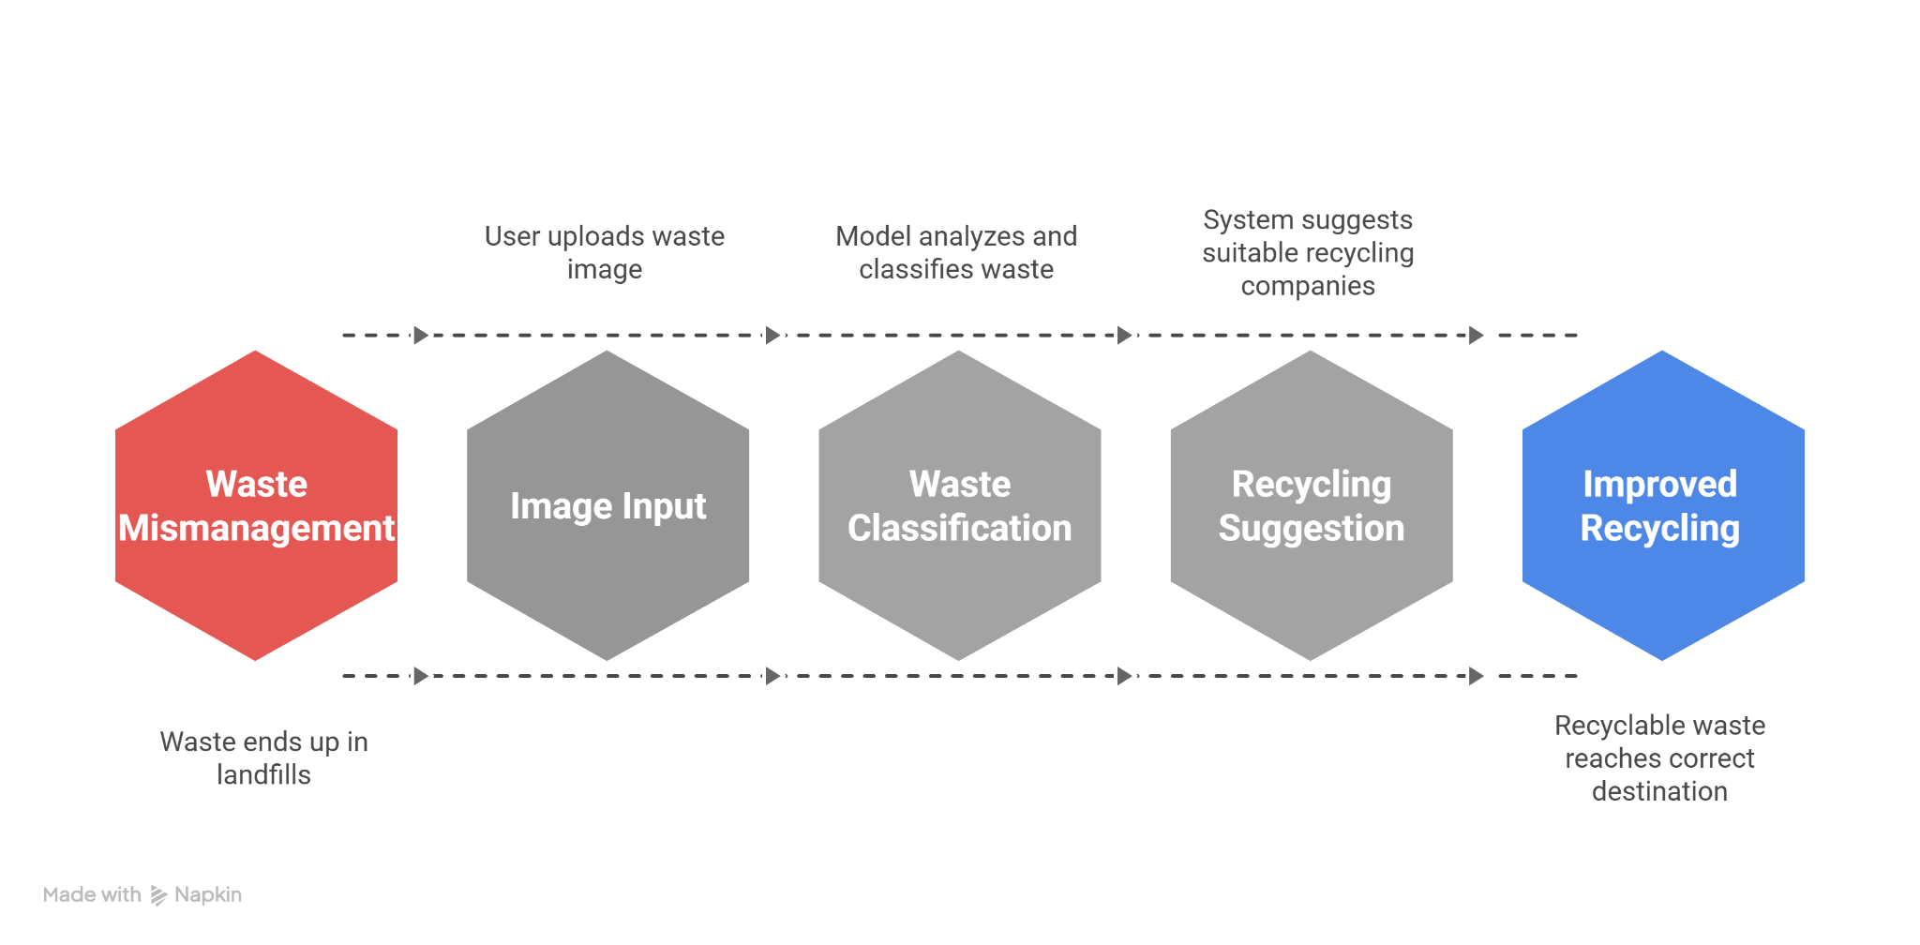
Project Overview - Introduction
This project aims to improve waste management using machine learning.The system takes an image of waste as input from the user.The image is processed and analyzed using a trained machine learning model.The model classifies the waste into different categories such as cloth, paper, plastic, and e-waste.After classification, the system identifies the type of waste.Based on this waste type, suitable recycling companies are suggested.These companies can reuse or recycle the waste material.This helps recyclable waste reach the correct destination instead of landfills.The system reduces manual waste segregation work.It also helps recycling companies get properly sorted raw materials.The project provides a practical and scalable recycling solution.

Slide 5
Waste Classification Dataset
Labeled waste images used to train MobileNetV2.
Classes:
Battery,Cardboard,Clothes,glass,metal,paper,plastic,shoes,trash,
Images resized to 224×224 and normalized.
link: https://www.kaggle.com/datasets/sumn2u/garbage-classification-v2
Recycling Company Dataset (CSV)
Fields:
Company Name | Waste_Needed | City | Website
Used to recommend suitable recyclers after waste classification.
Self-Created Dataset
Link:https://docs.google.com/spreadsheets/d/1Q746AnX1pFF9mdLH3WfGxZgfTCUXz_zd/edit?usp=sharing&ouid=112044830605616554329&rtpof=true&sd=true

Slide 6
End Users
Waste Management Workers
Example: A worker uploads an image of collected waste to identify its type.
Municipal Corporations
Example: City authorities use the system to improve waste segregation efficiency.
Recycling Companies
Example: A textile recycling company receives sorted cloth waste as raw material.
Smart City Projects
Example: Smart bins connected to the system for automated waste handling.
Industrial Waste Collectors
Example: Industries segregate metal or cardboard waste before recycling.
NGOs Working in Waste Management
Example: NGOs use the system to support recycling and sustainability programs.
Small Scrap Collectors
Example: Local scrap dealers identify and sell waste to the right recyclers.

Slide 7
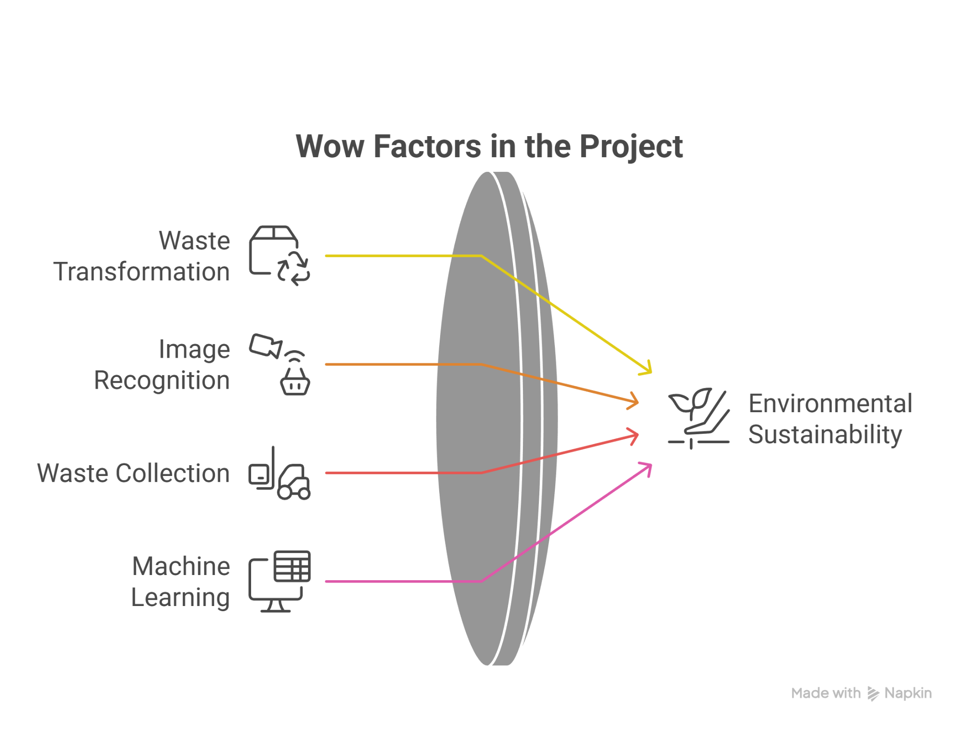
Wow Factors
The system transforms useless waste into valuable recyclable material.
A single image is enough to identify waste and decide its next step.
The project bridges waste collectors and recycling companies.
Machine learning is used not just for prediction, but for purpose.

Slide 8
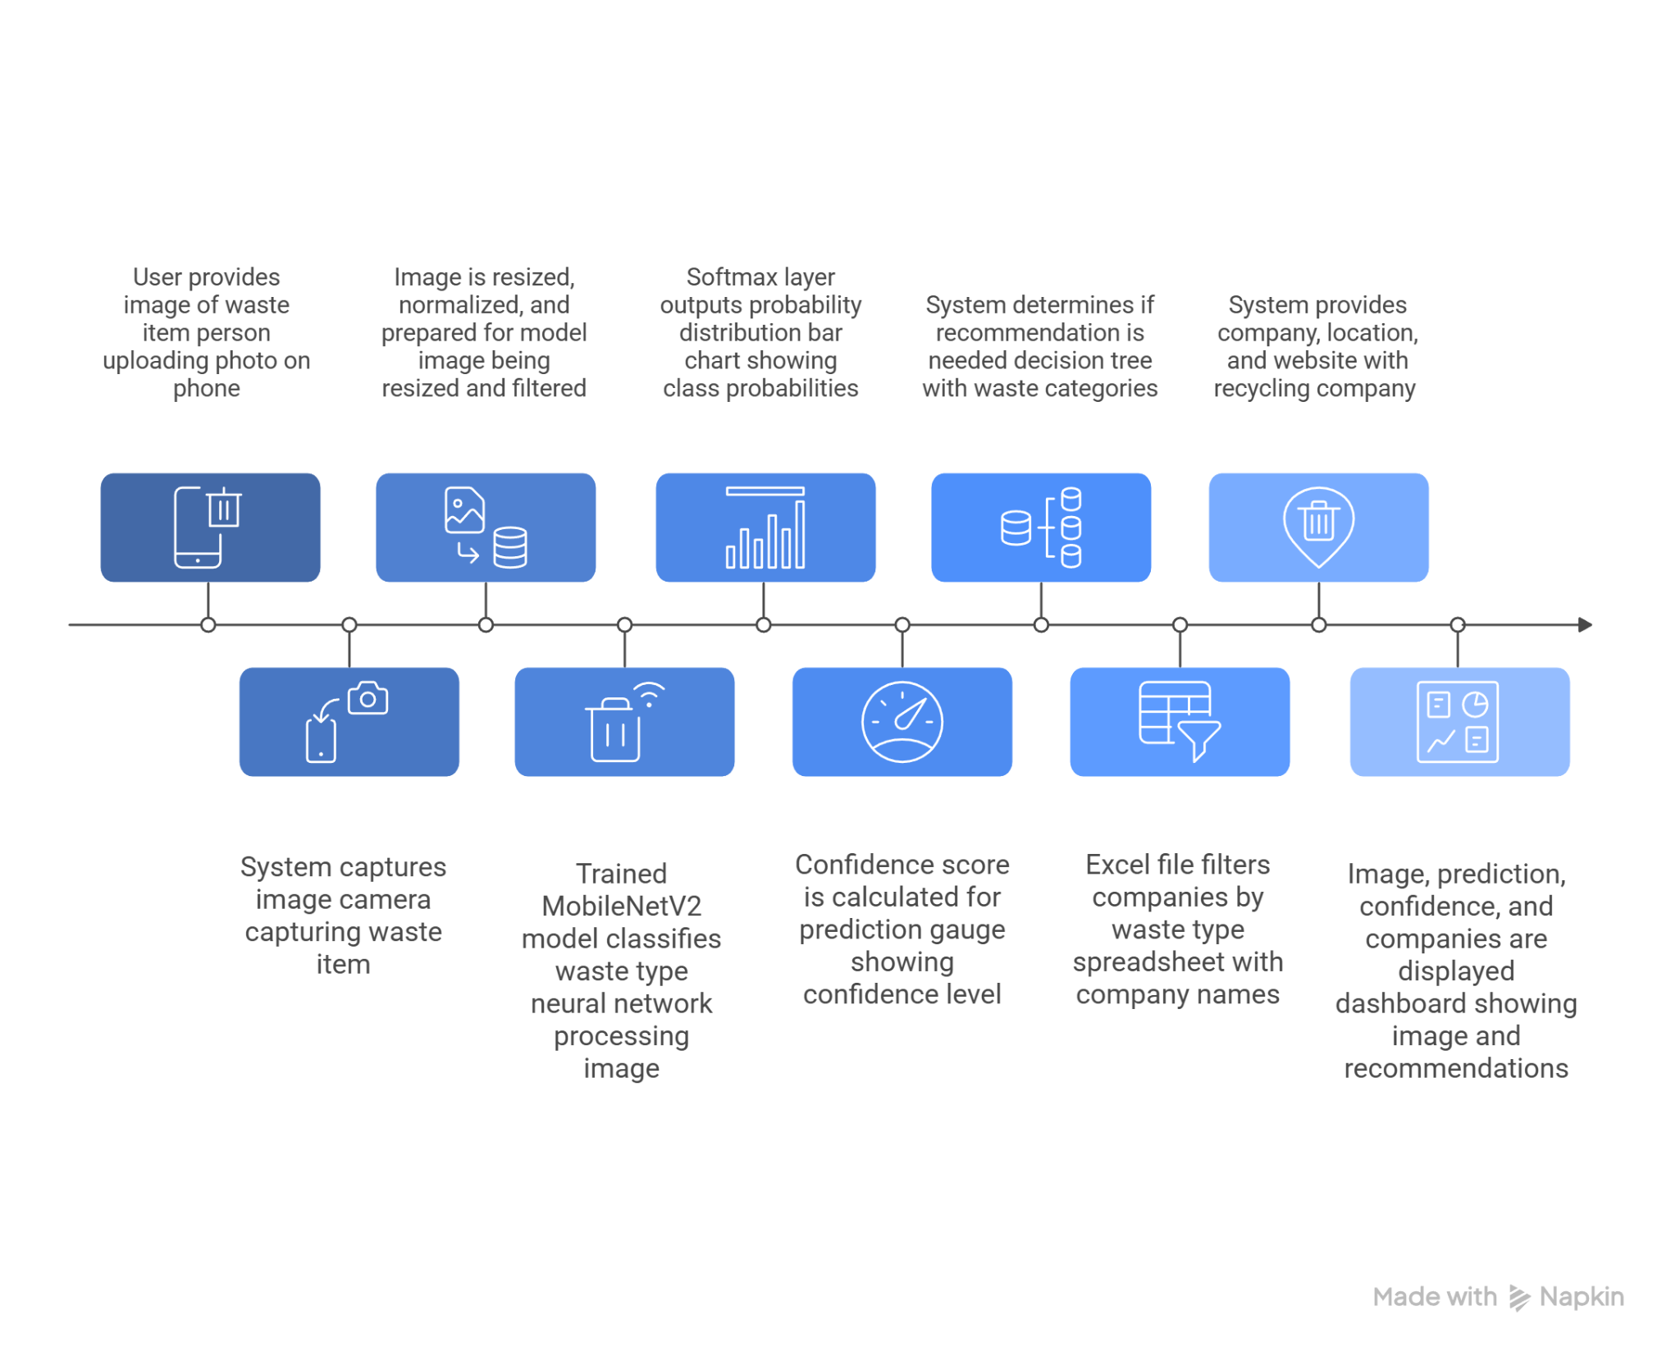
Work Flow of the Project

Slide 9
Technology Stack
Python 3.x – Core programming language used for model development and execution.
Jupyter Notebook – Interactive environment for training, testing, and visualizing results.
NumPy – Handles numerical operations and array manipulations for image data.
Pandas – Manages and filters the company database stored in Excel format.
TensorFlow 2.x – Deep learning framework used to build and train the neural network.
Keras API – High-level API for designing, training, and saving the model.
MobileNetV2 – Pre-trained CNN architecture used for transfer learning and classification.
Pillow (PIL) – Loads and processes images before feeding them to the model.
Matplotlib – Displays images and prediction results visually.
Excel (.xlsx) – Stores recycling company information as a structured dataset.
Keras SavedModel (.keras) – Format used to save and reload the trained model efficiently.

Slide 10
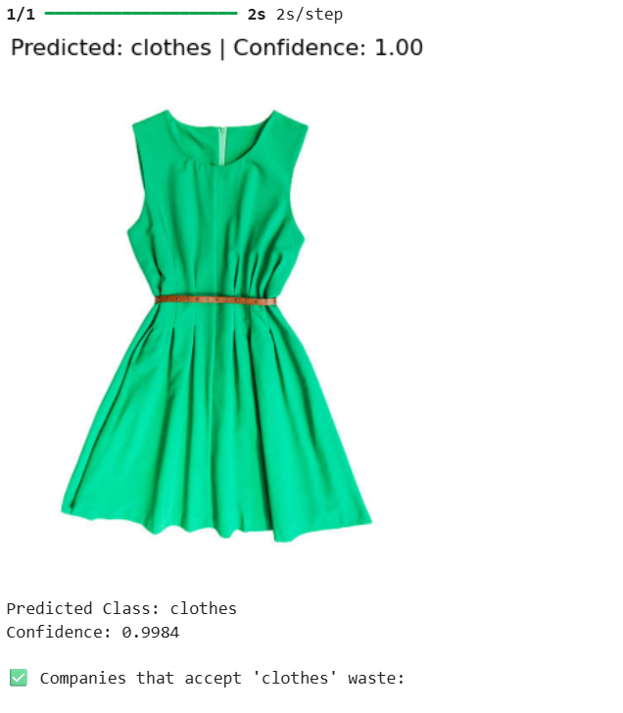

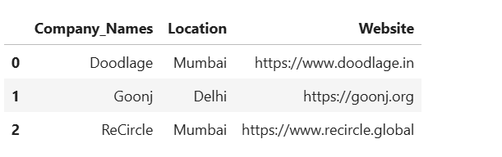
Results
Accurate classification of common waste categories using AI models
Improved recycling efficiency with reduced material loss
Enhanced worker safety through early detection of hazardous waste
Faster on-site decision making with real-time predictions
Reduced dependency on expert supervision due to automated waste segregation

Slide 11
Conclusion
The proposed AI-based waste management system effectively classifies waste using deep learning techniques.
The system improves recycling efficiency by minimizing manual errors and material loss.
Early detection of hazardous waste enhances safety for sanitation workers.
Automation reduces dependency on expert supervision and speeds up decision-making.
Overall, the model provides a scalable and intelligent solution for modern waste management.

Slide 12
References
G. Ginting and R. D. Apnena, “Smart Waste Management and Recycling Based on IoT using Machine Learning Algorithm,” J. Appl. Intell. Syst., vol. 9, no. 2, 2025, doi: 10.62411/jais.v9i2.10766.
S. Kargaonkar, S. Raghaw, P. Meena, and A. Tripathi, “Intelligent Waste Management Classification,” IJRASAT J. Appl. Sci. Eng. Technol., 2024.
S. S. G., A. Anub, B. Sreelekshmi et al., “Automated Waste Classification and Recycling Optimization Using AI,” Int. J. Environ. Sci., vol. 11, no. 24s, pp. 824–833, 2025.
F. Fotovvatikhah, I. Ahmedy, R. Md Noor, and M. U. Munir, “A Systematic Review of AI-Based Techniques for Automated Waste Classification,” Sensors, vol. 25, no. 10, 2025.

Slide 13
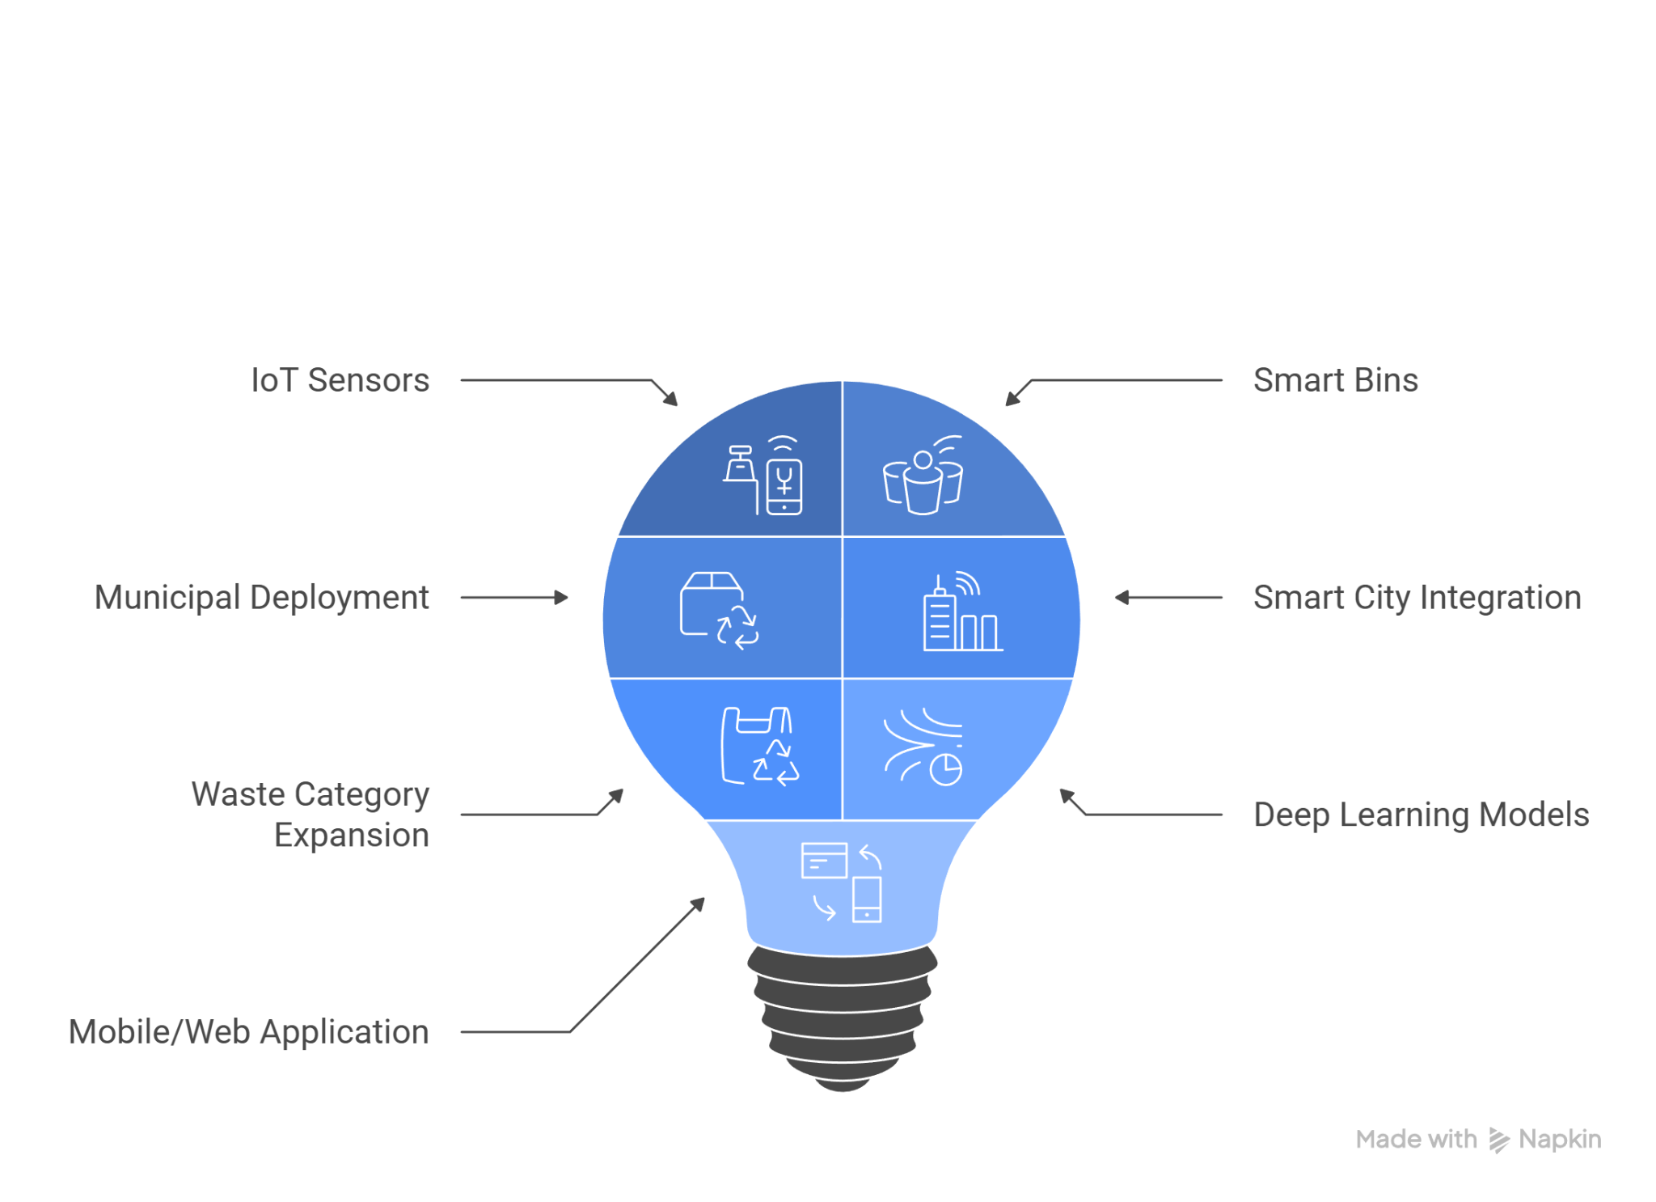
Future Perspective
Integration of IoT sensors and smart bins for real-time waste monitoring
Deployment of the system in municipal and smart city environments
Expansion to more waste categories, including hazardous and e-waste
Use of advanced deep learning models to improve accuracy and speed
Development of a mobile or web application for real-time tracking and alerts

Slide 14
Thank You
Notes:
Thank You !!

